Slide 1
Native iOS, Android, Mac, & Windows Mobile Apps in C# with Xamarin
Andrew McCormack
Xamarin Forms/Prism
mccorm79@gmail.com / https://github.com/amccorma

Slide 2
Xamarin’s Unique Approach
iOS C# UI
Android C# UI
Windows C# UI
Azure
Linux/Mono
CoreCLR
Shared C# Mobile
C# Server
Shared C# Client/Server
Shared C# codebase • 100% native API access • High performance
Notes:
With Xamarin it just isn’t your front end in C# it is your full backend server as well. With Azure or even on Linux running Mono or the CoreCLR your app is fully C# end to end!

Slide 3
Xamarin Is Free
Download at https://www.xamarin.com/platform
Get 30 day free trial
30 days Xamarin University Free
30 days Xamarin Test Cloud Free

Slide 4
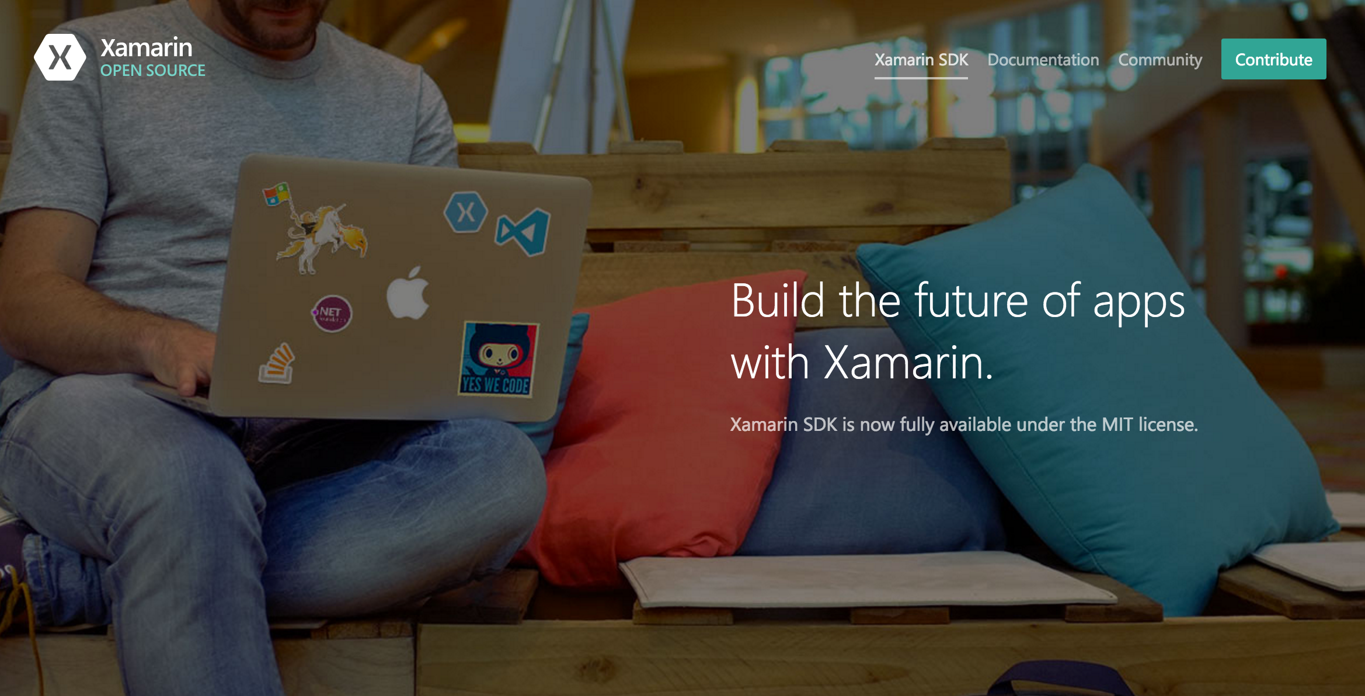
Open Source – open.xamarin.com

Slide 5
Windows APIs
Microsoft.Phone
Microsoft.Networking
Windows.Storage
Windows.Foundation
Microsoft.Devices
System.Net
System
System.IO
System.Linq
System.Xml
System.Data
System.Windows
System.Numerics
System.Core
System.ServiceModel
Notes:
If you have ever developed for a Windows Platform before these .NET namespaces might look familiar.
However, if we go to a new platform such as Windows Phone or Store we have a new SDK to use and a new set of namespaces.

Slide 6
iOS – 100% API Coverage
MapKit
UIKit
iBeacon
CoreGraphics
CoreMotion
System.Net
System
System.IO
System.Linq
System.Xml
System.Data
System.Windows
System.Numerics
System.Core
System.ServiceModel
Notes:
You can think of iOS and Android development the same with Xamarin. You can see we have all of our .NET namespaces and libraries, but Xamarin give us 100% api coverage of each iOS API in it’s SDK that we access view C#.

Slide 7
Android – 100% API Coverage
Text-to-speech
ActionBar
Printing Framework
Renderscript
NFC
System.Net
System
System.IO
System.Linq
System.Xml
System.Data
System.Windows
System.Numerics
System.Core
System.ServiceModel
Notes:
The same is true for Android as well.

Slide 8
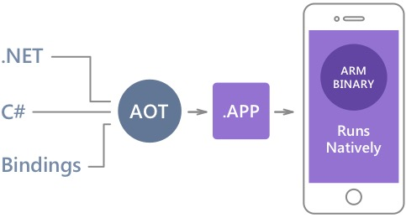
Native Performance
Xamarin.iOS does full Ahead Of Time (AOT) compilation to produce an ARM binary for Apple’s App Store.
Xamarin.Android takes advantage of Just In Time (JIT) compilation on the Android device.
Notes:
There is no compromise on performance.
Xamarin apps look and feel native because they are native.

Slide 9
Sharing Code

Slide 10
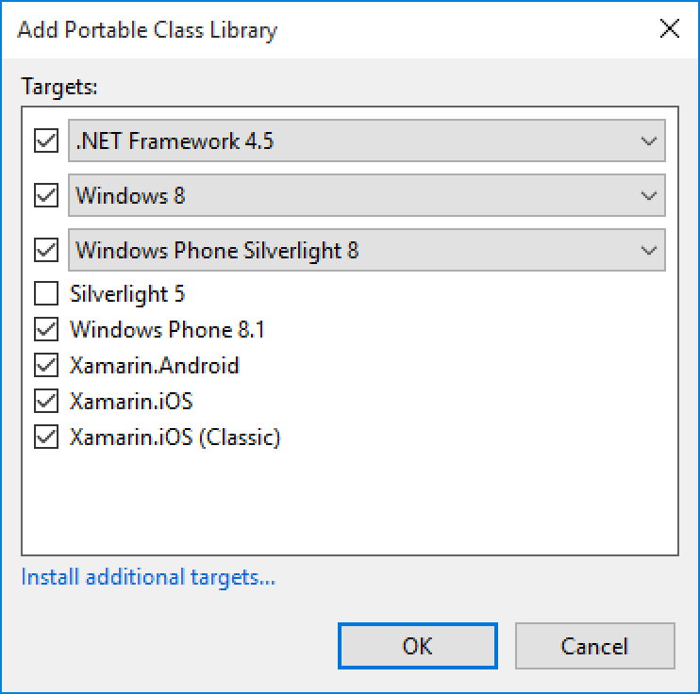
Portable Class Libraries
1 Assembly
Multiple Platforms
Including:
Xamarin.iOS and Xamarin.Android

Slide 11
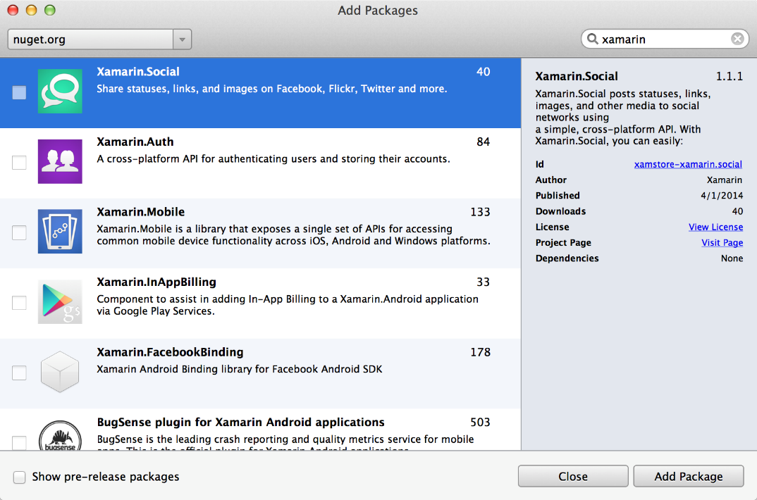
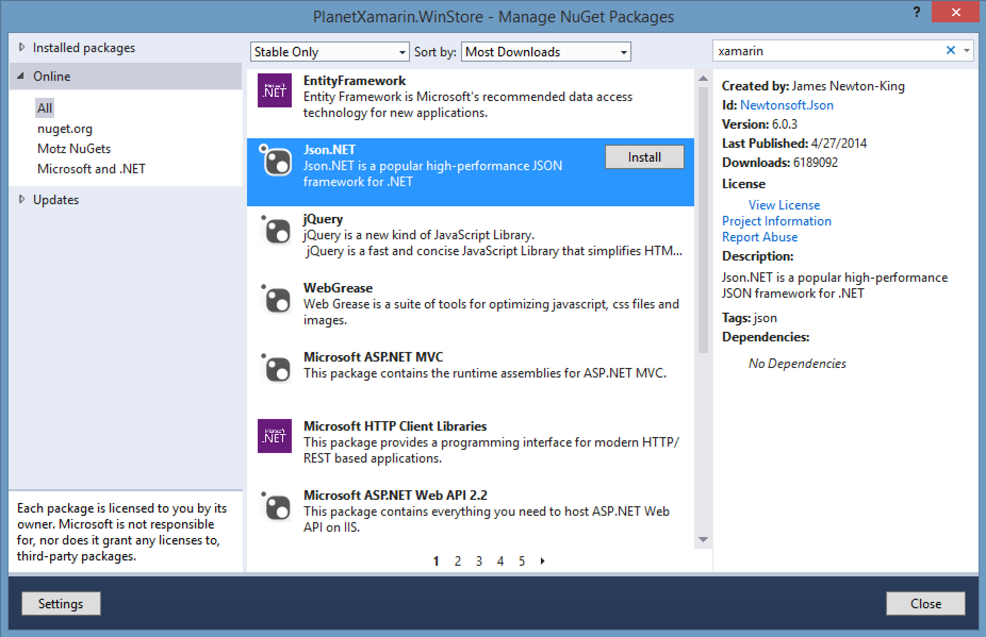
NuGet
Notes:
Use all of your favorite libraries from NuGet or share and distribute your own!

Slide 12
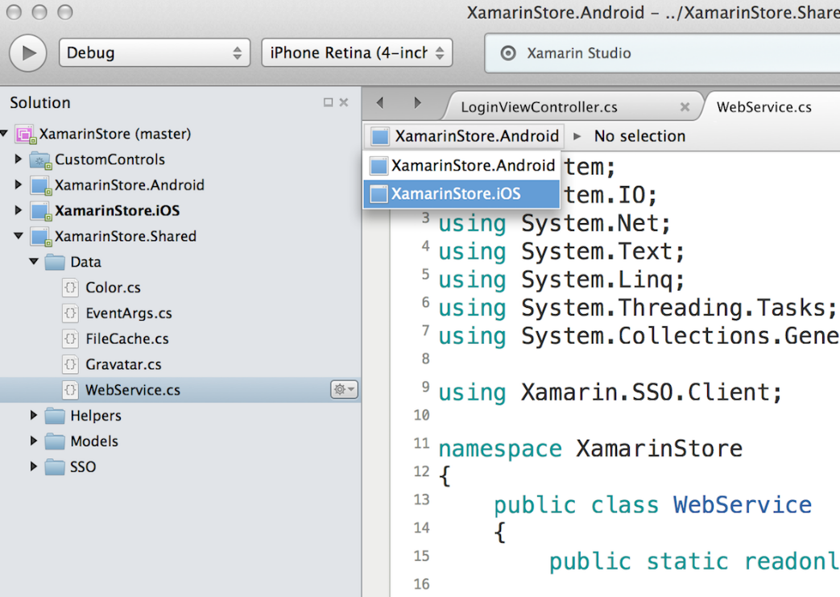
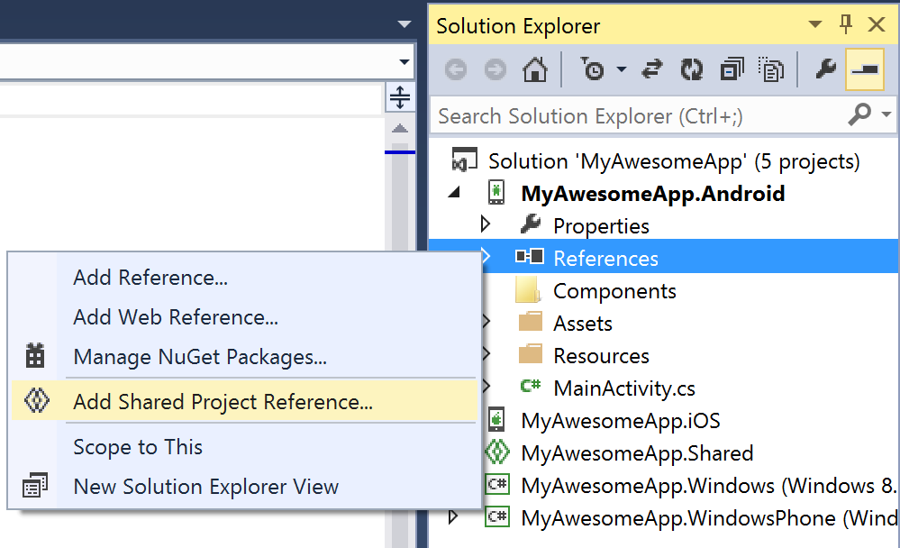
Shared Projects

Slide 13
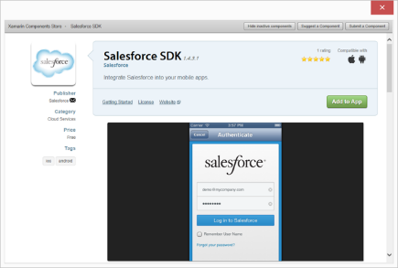
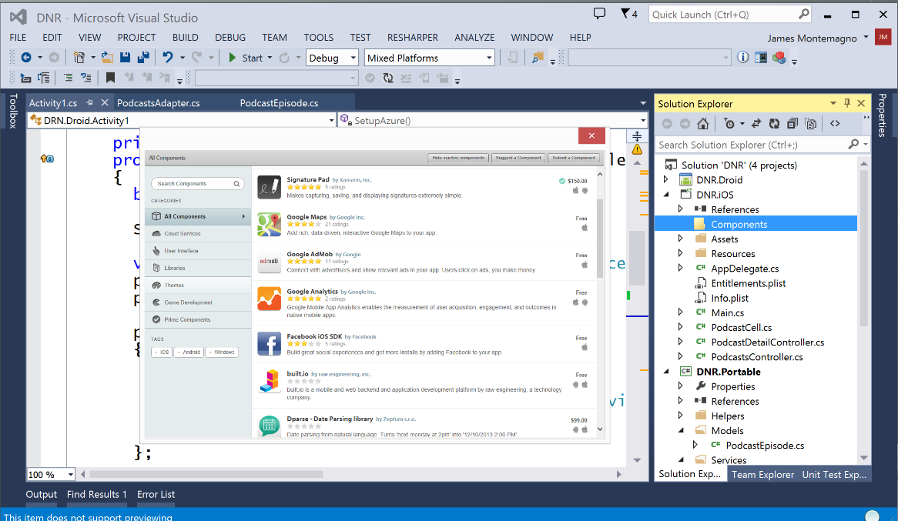
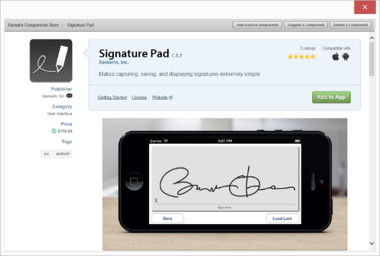
Xamarin Component Store
Build Apps Faster
Add high quality pre-built app components directly from Visual Studio and Xamarin Studio
Beautiful, cross-platform UI controls, cloud services, and enterprise backend integrations are just a few clicks away

Slide 14
Meet Xamarin.Forms
Build native UIs for iOS, Android, and Windows Phone from a single, shared C# codebase.
Notes:
Xamarin Forms is a new set of APIs allowing you to quickly and easily write shared User Interface code that is still rendered natively on each platform, while still providing direct access to the underlying SDKs if you need it.

Slide 15

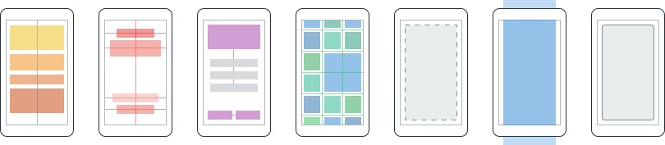
Layouts
Pages
Content
MasterDetail
Navigation
Tabbed
Carousel
Stack
Absolute
Relative
Grid
ContentView
ScrollView
Frame
Notes:
First you have a set of pages for each screen of your application
There are things like Content, and MasterDetail which gives you a nice flyout
With a tabbed view you get the correct look on each platform
iOS on bottom, Android on top, and on WP you have a Pivot control
Inside of a page are layouts
A lot of options from something simple like a stack panel to complex and powerful grids

Slide 16
Controls
ActivityIndicator
BoxView
Button
DatePicker
Editor
Entry
Image
Label
ListView
Map
OpenGLView
Picker
ProgressBar
SearchBar
Slider
Stepper
TableView
TimePicker
WebView
EntryCell
ImageCell
SwitchCell
TextCell
ViewCell
Notes:
You have more than 40 controls, layouts, and pages to mix and match from.
These are all of the controls you have out of the box, you can of course create your own.
What is unique is you get the native control and have access to it.
Consider an Entry Field
On iOS it is mapped to UITextField
Android it is EditText
Windows Phone it is a TextBox

Slide 17
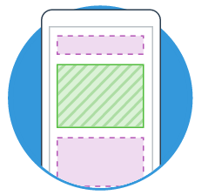
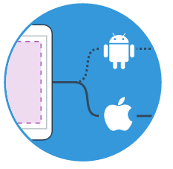
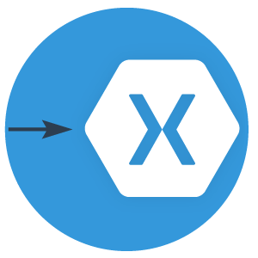
Extensibility
Embed Custom Views Anywhere
Not only are Xamarin.Forms pages mixable with custom screens, you can embed custom views built directly against Xamarin.iOS and Xamarin.Android into Xamarin.Forms pages.
Call Platform APIs via Shared Services
Need platform-specific functionality within a Xamarin.Forms page, such as querying the accelerometer? We’ve included services that quickly and easily abstract platform-specific API calls to keep you writing as much shared code as possible.
Easy migration to the Xamarin Platform
When your native platform integration requirements outgrow Xamarin.Forms, your shared code is easily migrated to Xamarin.iOS and Xamarin.Android using the full Xamarin platform.
Notes:
With Xamarin.Forms you can easily extend and embed custom views, mix and match screens, called native apis, or even easily migrate to a traditional app and share your backend logic.

Slide 18

Test
Notes:
Xamarin is your complete mobile solution.
Xamarin Platform is usually what you hear about which is building native iOS, Android, Mac, and Windows Apps all in C#
However Xamarin offers a wide range of products for developers to go mobile including Test Cloud, Hockey App, and a way to learn all of mobile with University.

Slide 19
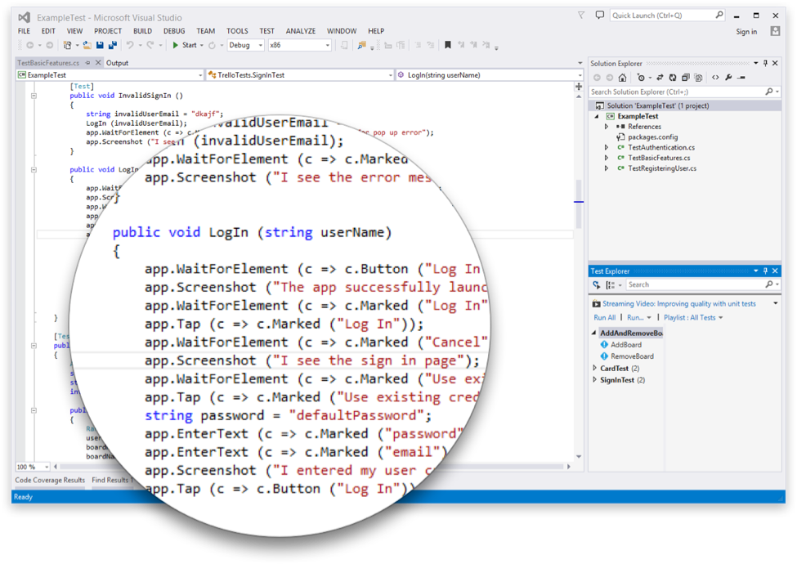
Introducing Xamarin.UITest
Create Automated User Interface tests all in C#
Upload to the Test Cloud or run against a Device or Simulator
Run directly from Visual Studio or Xamarin Studio
Freely available for testing on a Simulator*
Works on ANY app: Native, Hybrid, or Xamarin
Notes:
This is where Xamarin.UITest comes in to help with this shift. Xamarin.UITest is a framework that ties in directly to the Nunit testing framework to write the UI tests. You can even run them directly against a simulator for free to do regression tests on your applications.
Freely available for testing on a Simulator*

Slide 20
Test Recorder for Visual Studio
Record UITests from Visual Studio
Replay or ship to Test Cloud
Use Touch Screen on Android Emulator

Slide 21

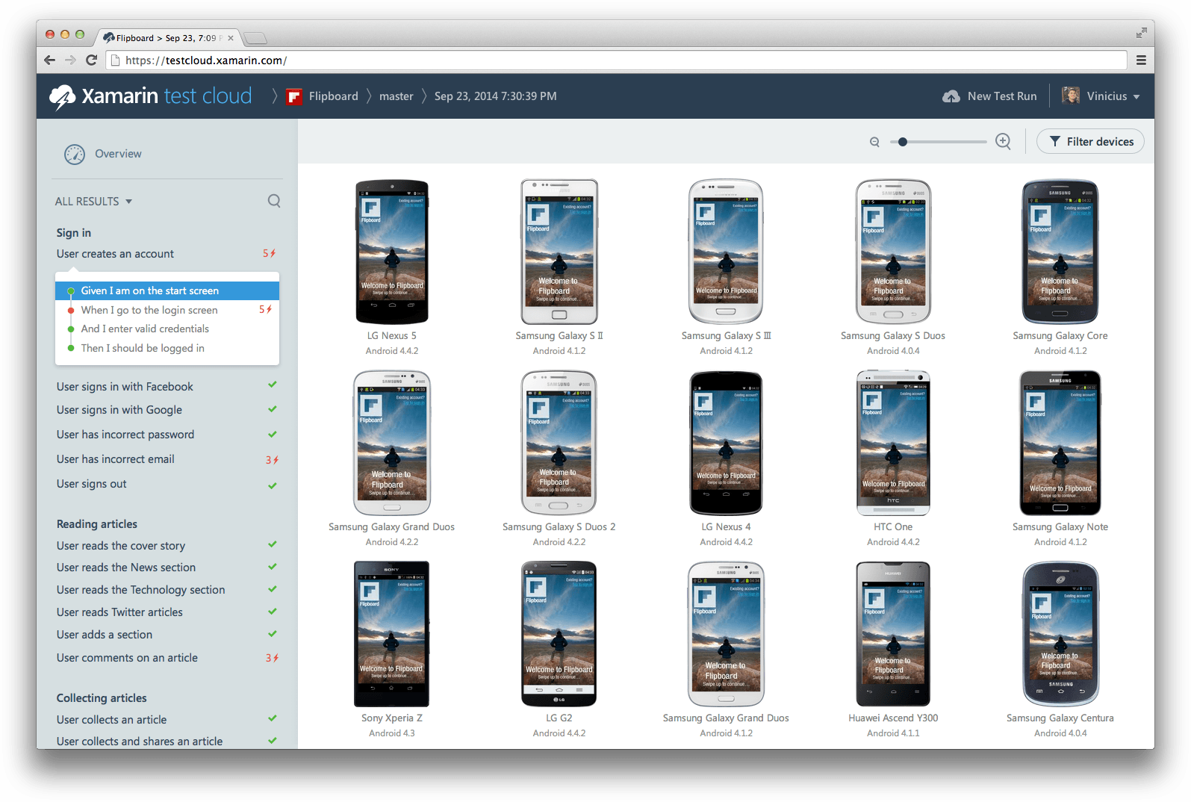
xamarin.com/testcloud
Notes:
Take test scripts and test again thousands of physical devices!
All Xamarin subscribers get free device time! Check store.xamarin.com for details.

Slide 22
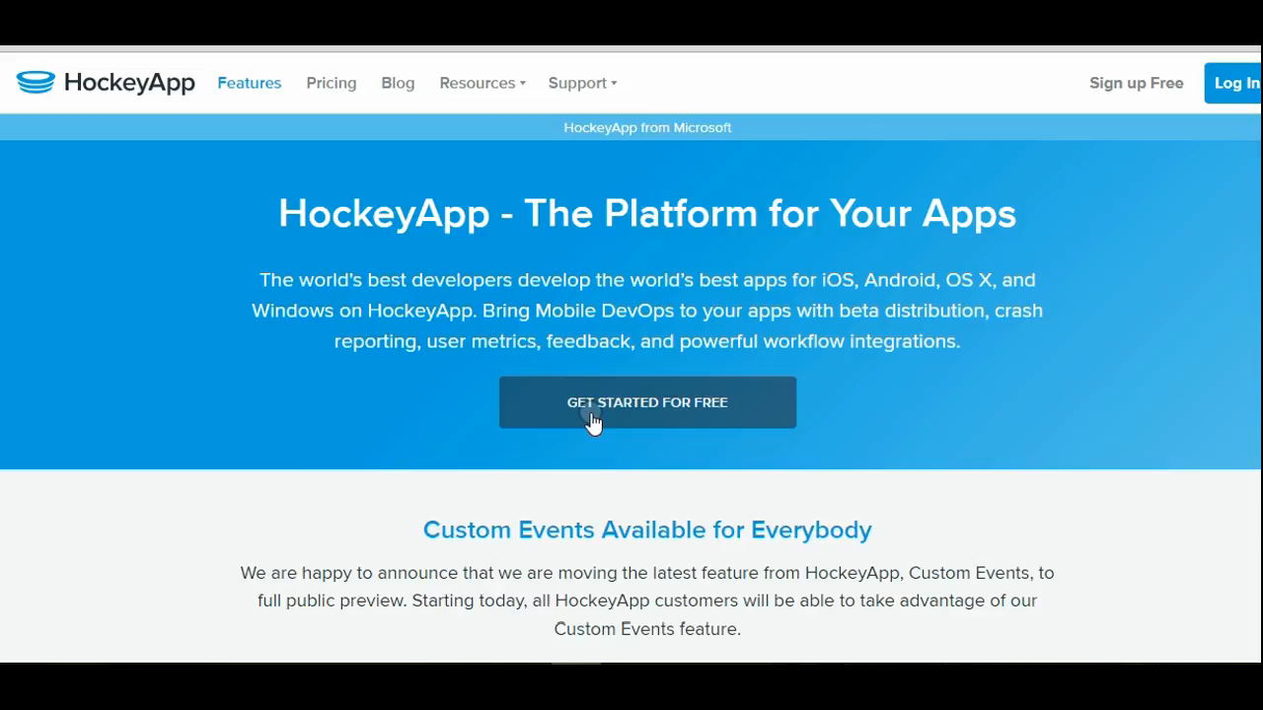
Hockeyapp Demo

Slide 23

What is Prism?
XAML Application Framework
Guidance
Patterns & Practices
Testable & Maintainable
Open Source
http://github.com/PrismLibrary
.NET Foundation

Slide 24
MVVM
Design Pattern
View
ViewModel
Model
Presentation and Presentation Logic
Business Logic and Data

Slide 25
DelegateCommand
ICommand SomeCommand = new DelegateCommand(Execute, CanExecute);
private void Execute()
{
//do something
}
private bool CanExecute()
{
return true;
}

Slide 26
DelegateCommand<T>
ICommand SomeCommand = new DelegateCommand<string>(Execute, CanExecute);
private void Execute(string param)
{
//do something
}
private bool CanExecute(string param)
{
return true;
}

Slide 27
DelegateCommand Async
ICommand SomeCommand = DelegateCommand.FromAsyncHandler(ExecuteAsync);
Task ExecuteAsync()
{
//do something
}
ICommand SomeCommand = DelegateCommand<string>.FromAsyncHandler(ExecuteAsync);
Task ExecuteAsync(string param)
{
//do something
}

Slide 28
A Better Way to Navigate
Decoupled Navigation
No Page references
No ViewModel references
Based on URIs
This means strings
Relative (default) – nav occurs relative to calling VM
Absolute – replaces entire nav stack
Pages must be registered for navigation
INavigationService
Navigate
GoBack

Slide 29
Passing Parameters
Use NavigationParameters
Dictionary of objects (Key/Value)
Pass parameters via INavigationService
Navigate
GoBack

Slide 30
Messaging

Slide 31
Using IEventAggregator
//event
public class SavedEvent : PubSubEvent<Person> { }
//publisher
IEventAggregator.GetEvent<SavedEvent>().Publish(somePersonInstance);
//subscriber
IEventAggregator.GetEvent<SavedEvent>().Subscribe(SomethingSaved);
//delegate
void SomethingSaved(Person p)
{
//do something
}

